Slide 1

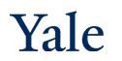
Deep Learning Theory and Applications Losses and activations
AMTH/CBB 663
CPSC 452/552

Slide 2

Being wrong is unpleasant
Suppose you give a piano concert before an audience and completely and obviously mess up the performance
Humans get embarrassed and so you would likely learn from your mistake quickly
In contrast, we learn more slowly when our errors are less-well defined
What about neural networks?

Slide 3
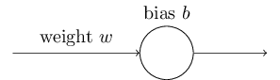
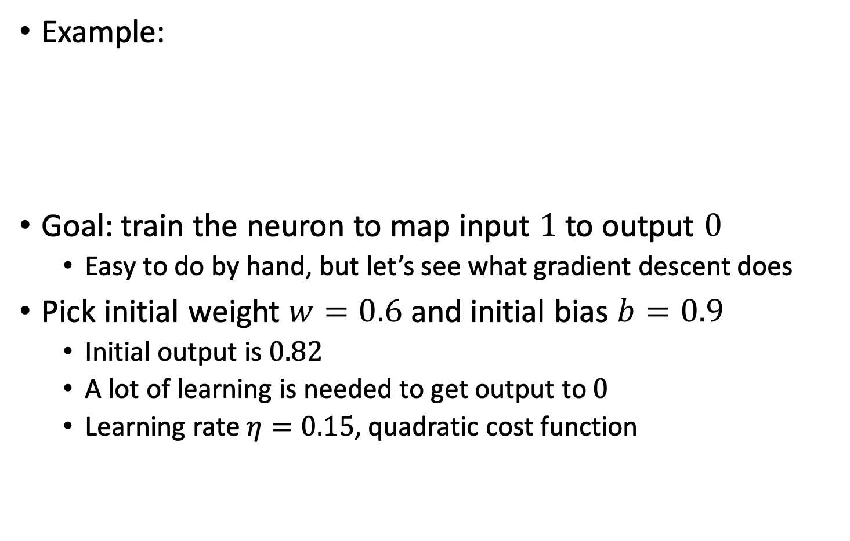
Do neural networks learn quickly?
Example:
Goal: train the neuron to map input $1$ to output $0$
Easy to do by hand, but let’s see what gradient descent does
Pick initial weight $w=0.6$ and initial bias $b=0.9$
Initial output is $0.82$
A lot of learning is needed to get output to $0$
Learning rate $η=0.15$, quadratic cost function
Notes:
Show the first animation/computation

Slide 4
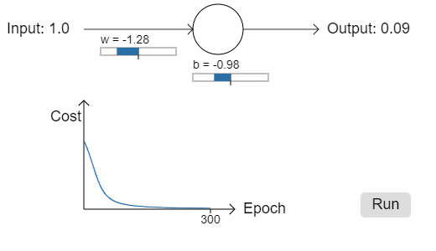

Do neural networks learn quickly?
The neuron rapidly learns a weight and bias that decreases cost
Achieves output of $0.09$ (pretty good)

Slide 5
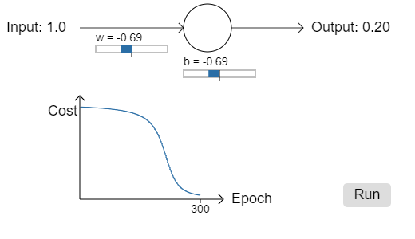

Do neural networks learn quickly?
Change starting weights and bias to be $2.0$
Initial output is 0.98
Learning occurs much more slowly
Weight and bias change little for first 150 epochs

Slide 6
Neural networks aren’t like humans
Humans often learn fastest when we’re very wrong
The artificial neuron learns fastest when it’s just a little wrong
True in more general networks as well
Why is learning so slow?

Slide 7
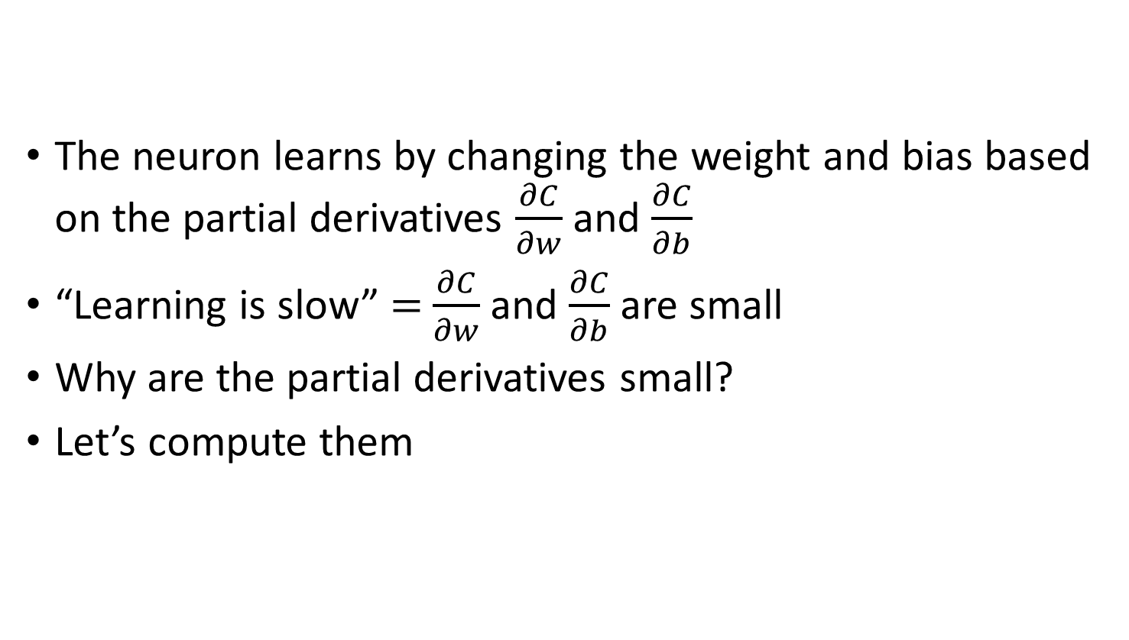
Why is learning so slow?
The neuron learns by changing the weight and bias based on the partial derivatives $\frac{∂C}{∂w}$ and $\frac{∂C}{∂b}$
“Learning is slow” $=$ $\frac{∂C}{∂w}$ and $\frac{∂C}{∂b}$ are small
Why are the partial derivatives small?
Let’s compute them

Slide 8

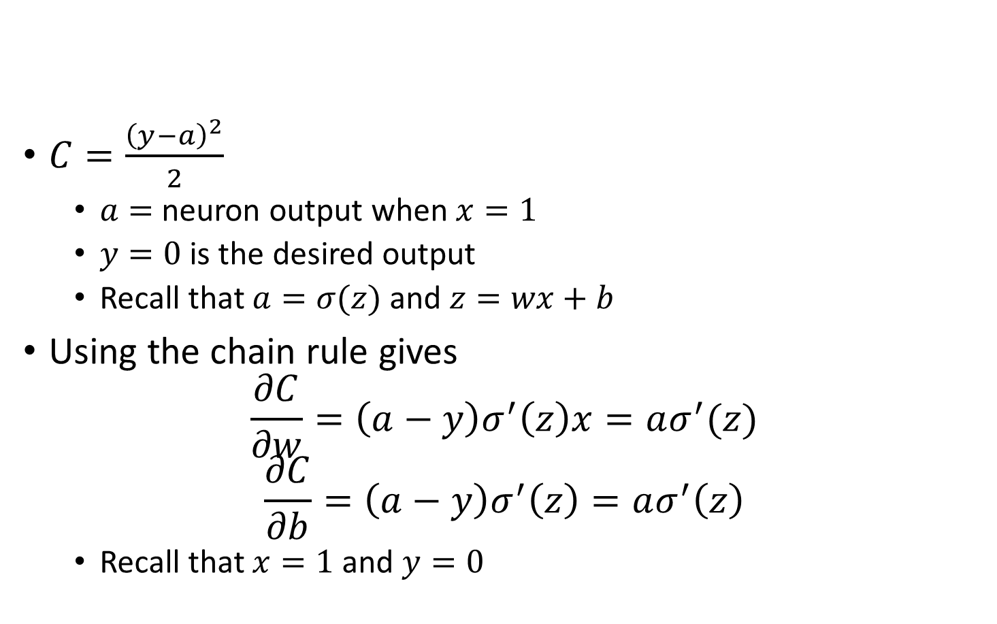

Why is learning so slow?
$C=\frac{{\left(y−a\right)}^{2}}{2}$
$a=$ neuron output when $x=1$
$y=0$ is the desired output
Recall that $a=σ(z)$ and $z=wx+b$
Using the chain rule gives
$$\frac{∂C}{∂w}=\left(a−y\right)σ^{′}\left(z\right)x=aσ^{′}(z)$$
$$\frac{∂C}{∂b}=\left(a−y\right)σ^{′}\left(z\right)=aσ^{′}\left(z\right)$$
Recall that $x=1$ and $y=0$

Slide 9
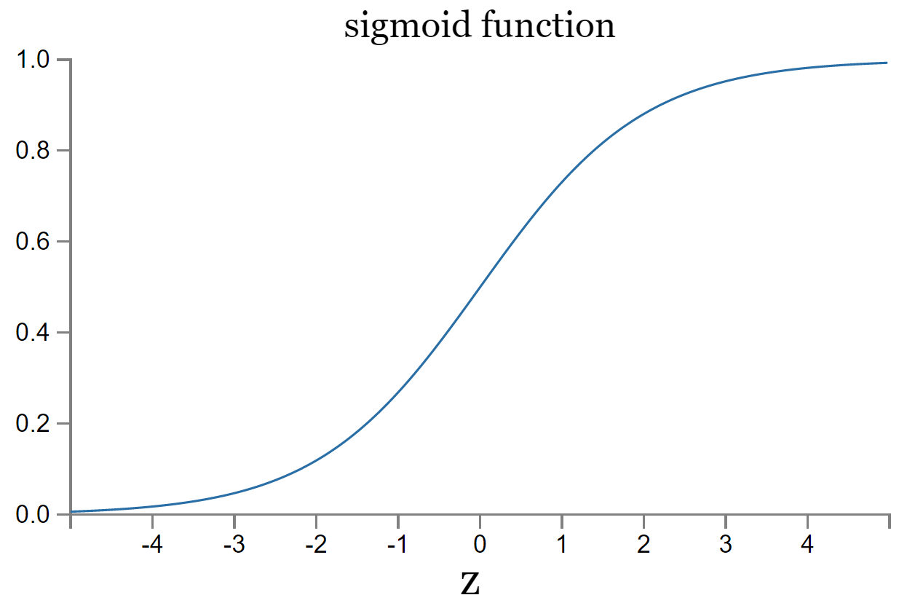

Why is learning so slow?
Recall the sigmoid function
Curve is flat when the output is close to $1$
$σ^{′}\left(z\right)$ gets very small
$\frac{∂C}{∂w}=aσ^{′}\left(z\right)=\frac{∂C}{∂b}$ get very small
This occurs in more general neural networks as well

Slide 10
How can we fix this?
1. Change the cost function so that it doesn’t depend on the activation function directly
2. Change the activation function
Lets try both!

Slide 11
Changing the cost function
A cost function needs to compare the neural network output with the actual output
If the neural network output is a sigmoid then it gives a value between 0-1 that indicates the “probability of the output” (…in the case of one output)
→We can use a method of comparing probability distributions
Cross entropy, KL Divergence
Notes:
Why does this help with the learning slowdown problem? And is it even a cost function?

Slide 12
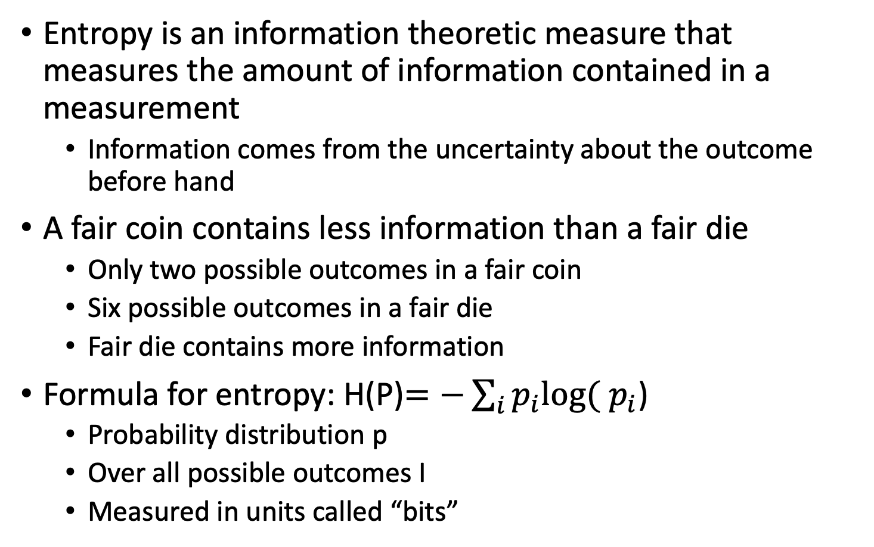
Entropy from Information Theory
Entropy is an information theoretic measure that measures the amount of information contained in a measurement
Information comes from the uncertainty about the outcome before hand
A fair coin contains less information than a fair die
Only two possible outcomes in a fair coin
Six possible outcomes in a fair die
Fair die contains more information
Formula for entropy: H(P)$=−\sum_{i}{p_{i}log⁡(}$ $p_{i}$)
Probability distribution p
Over all possible outcomes I
Measured in units called “bits”

Slide 13
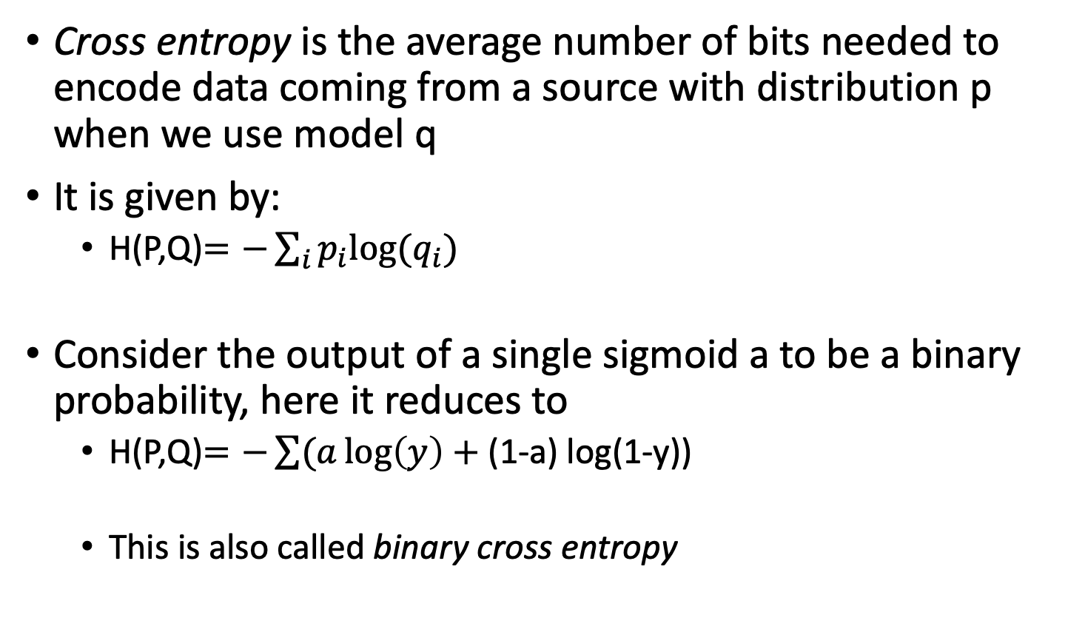
Cross Entropy
Cross entropy is the average number of bits needed to encode data coming from a source with distribution p when we use model q
It is given by:
H(P,Q)$=−\sum_{i}{p_{i}log⁡(q_{i})}$
Consider the output of a single sigmoid a to be a binary probability, here it reduces to
H(P,Q)$=−\sum{(a\log\left(y\right)+}$ (1-a) log(1-y))
This is also called binary cross entropy

Slide 14
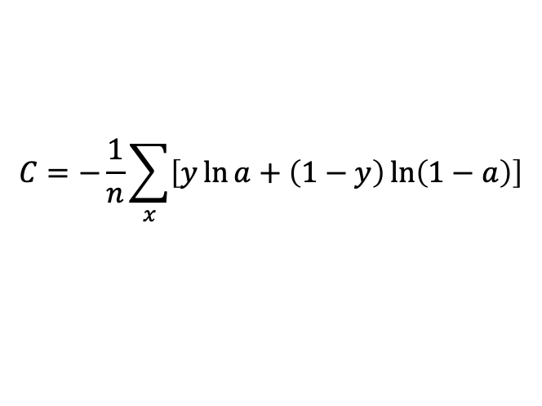
Generalizing to many outputs
Outputs from multiple sigmoid neurons do not form a probability distribution (why)
Generalization of binary cross entropy to multi output functions is just by summing the binary cross entropy at each neuron
$$C=−\frac{1}{n}\sum_{x}{\left[y\ln{a}+\left(1−y\right)\ln\left(1−a\right)\right]}$$

Slide 15
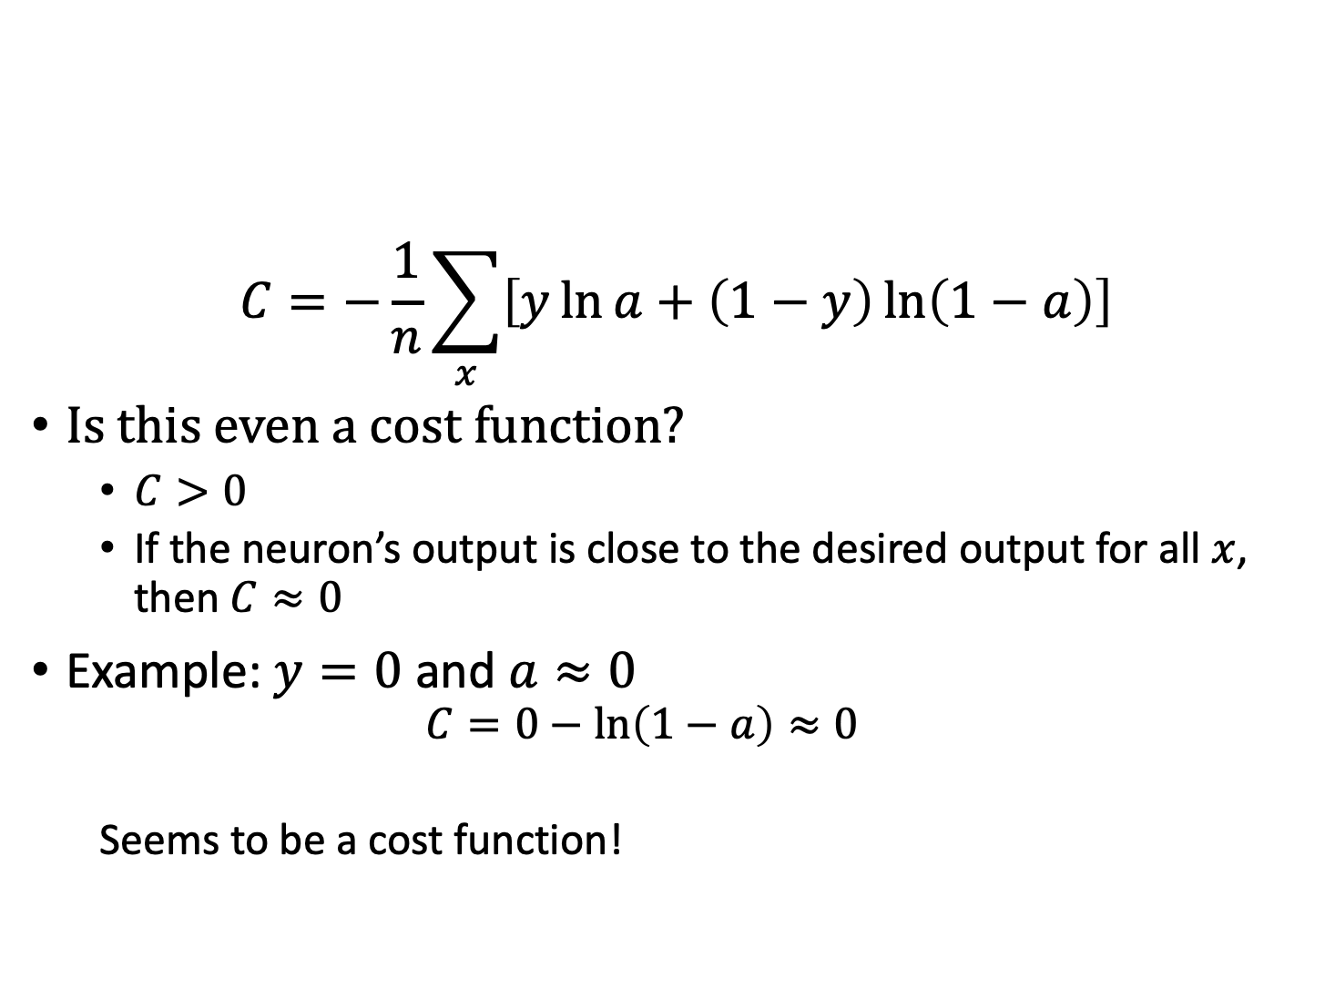
Cross-entropy Cost function
$$C=−\frac{1}{n}\sum_{x}{\left[y\ln{a}+\left(1−y\right)\ln\left(1−a\right)\right]}$$
Is this even a cost function?
$C>0$
If the neuron’s output is close to the desired output for all $x$, then $C≈0$
Example: $y=0$ and $a≈0$
$$C=0−\ln\left(1−a\right)≈0$$
Seems to be a cost function!

Slide 16
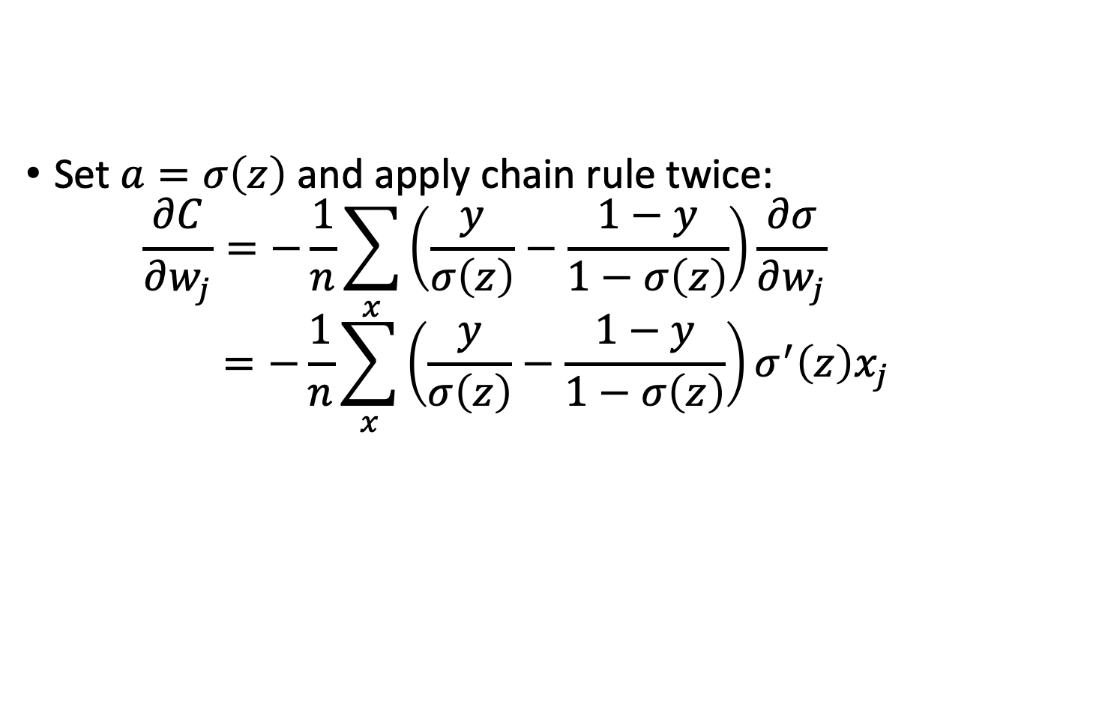
Will it help vanishing gradients?
Set $a=σ\left(z\right)$ and apply chain rule twice:
$$\frac{∂C}{∂w_{j}}=−\frac{1}{n}\sum_{x}{\left(\frac{y}{σ\left(z\right)}−\frac{1−y}{1−σ\left(z\right)}\right)\frac{∂σ}{∂w_{j}} }$$
$$=−\frac{1}{n}\sum_{x}{\left(\frac{y}{σ\left(z\right)}−\frac{1−y}{1−σ\left(z\right)}\right)σ^{′}\left(z\right)x_{j}}$$

Slide 17
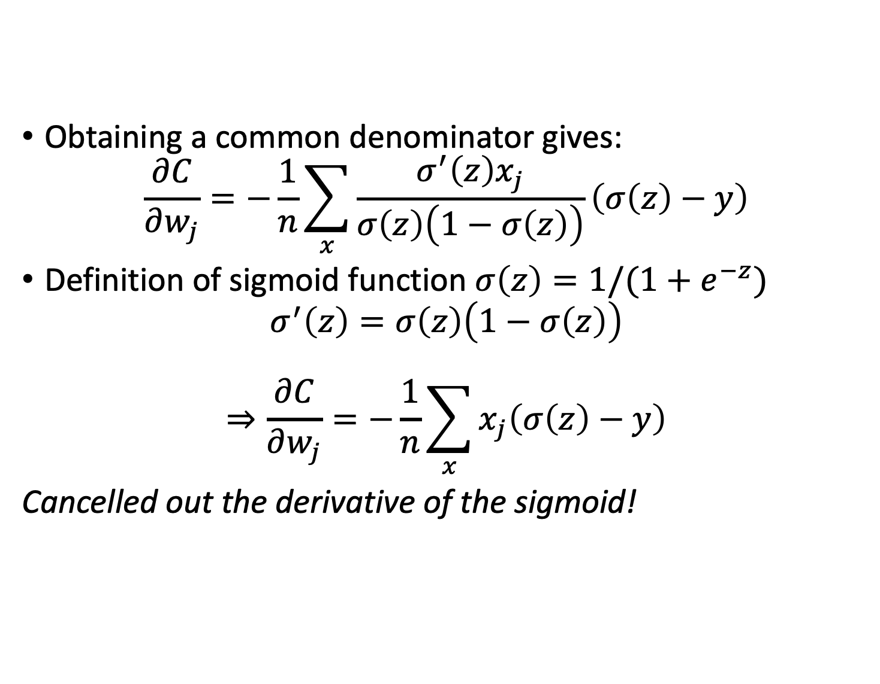
The cross-entropy cost function
Obtaining a common denominator gives:
$$\frac{∂C}{∂w_{j}}=−\frac{1}{n}\sum_{x}{\frac{σ^{′}\left(z\right)x_{j}}{σ\left(z\right)\left(1−σ\left(z\right)\right)}\left(σ\left(z\right)−y\right)}$$
Definition of sigmoid function $σ\left(z\right)=1/(1+e^{−z})$
$$σ^{′}\left(z\right)=σ\left(z\right)\left(1−σ\left(z\right)\right)$$
$$⇒\frac{∂C}{∂w_{j}}=−\frac{1}{n}\sum_{x}{x_{j}\left(σ\left(z\right)−y\right)}$$
Cancelled out the derivative of the sigmoid!

Slide 18
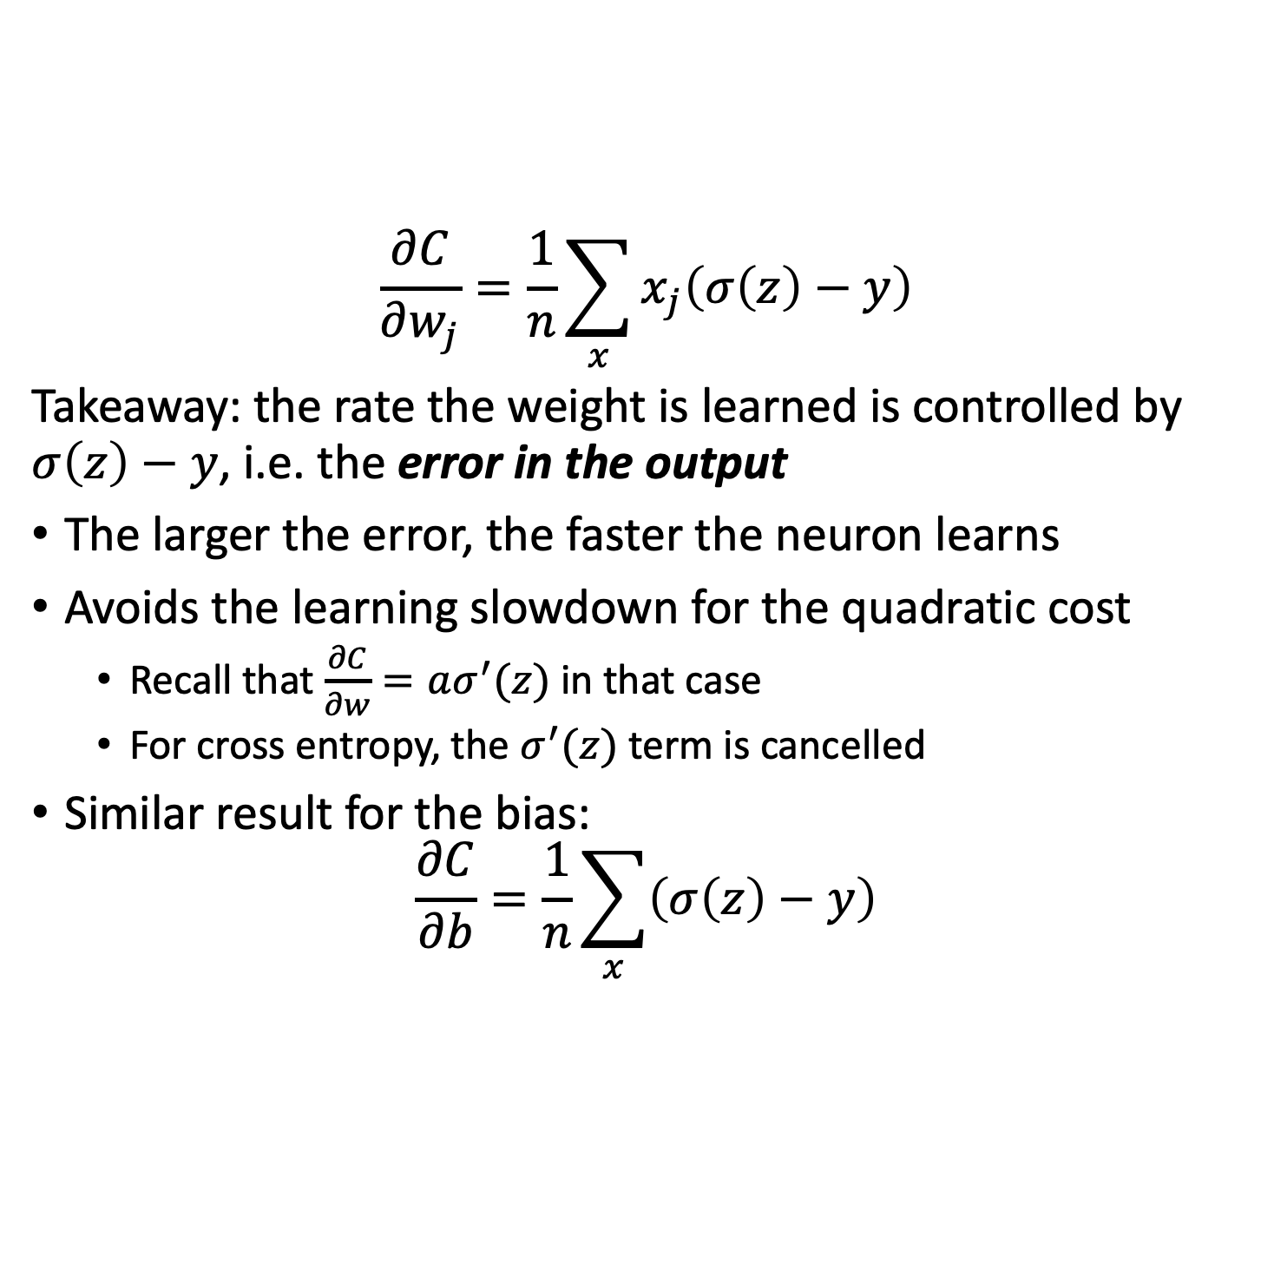
The cross-entropy cost function
$$\frac{∂C}{∂w_{j}}=\frac{1}{n}\sum_{x}{x_{j}\left(σ\left(z\right)−y\right)}$$
Takeaway: the rate the weight is learned is controlled by $σ\left(z\right)−y$, i.e. the error in the output
The larger the error, the faster the neuron learns
Avoids the learning slowdown for the quadratic cost
Recall that $\frac{∂C}{∂w}=aσ^{′}(z)$ in that case
For cross entropy, the $σ^{′}(z)$ term is cancelled
Similar result for the bias:
$$\frac{∂C}{∂b}=\frac{1}{n}\sum_{x}{\left(σ\left(z\right)−y\right)}$$

Slide 19
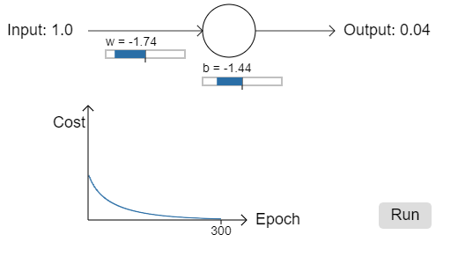
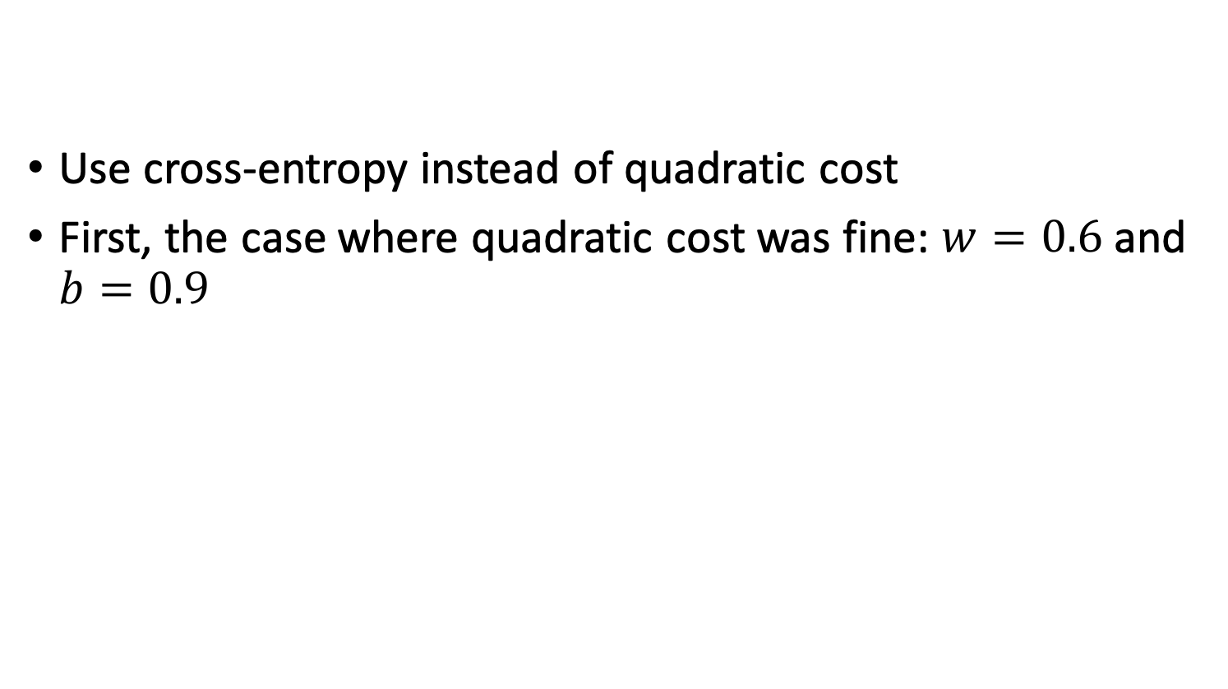
The cross-entropy cost function
Use cross-entropy instead of quadratic cost
First, the case where quadratic cost was fine: $w=0.6$ and $b=0.9$
Notes:
Neuron learns perfectly well in this case as before

Slide 20
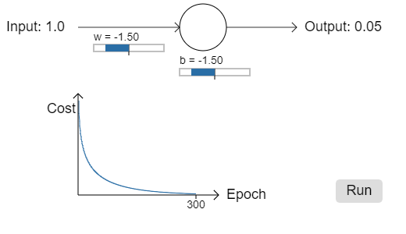

The cross-entropy cost function
Use cross-entropy instead of quadratic cost
Now, the case where quadratic cost got stuck: $w=2.0$ and $b=2.$
Notes:
This time the neuron learns quickly as hoped. The slope of the cost curve is much steeper initially than for the case with quadratic cost

Slide 21
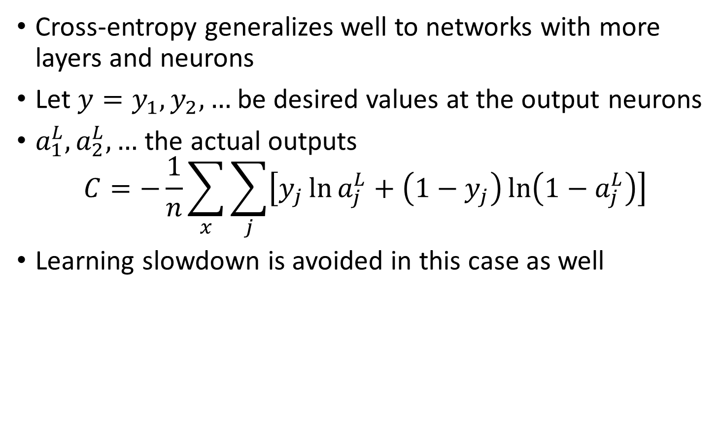
The cross-entropy cost function
Cross-entropy generalizes well to networks with more layers and neurons
Let $y=y_{1},y_{2},…$ be desired values at the output neurons
$a_{1}^{L},a_{2}^{L},…$ the actual outputs
$$C=−\frac{1}{n}\sum_{x}{\sum_{j}{\left[y_{j}\ln{a_{j}^{L}+\left(1−y_{j}\right)\ln\left(1−a_{j}^{L}\right)}\right]}}$$
Learning slowdown is avoided in this case as well
Notes:
Same as earlier expression except we sum now over all output neurons

Slide 22
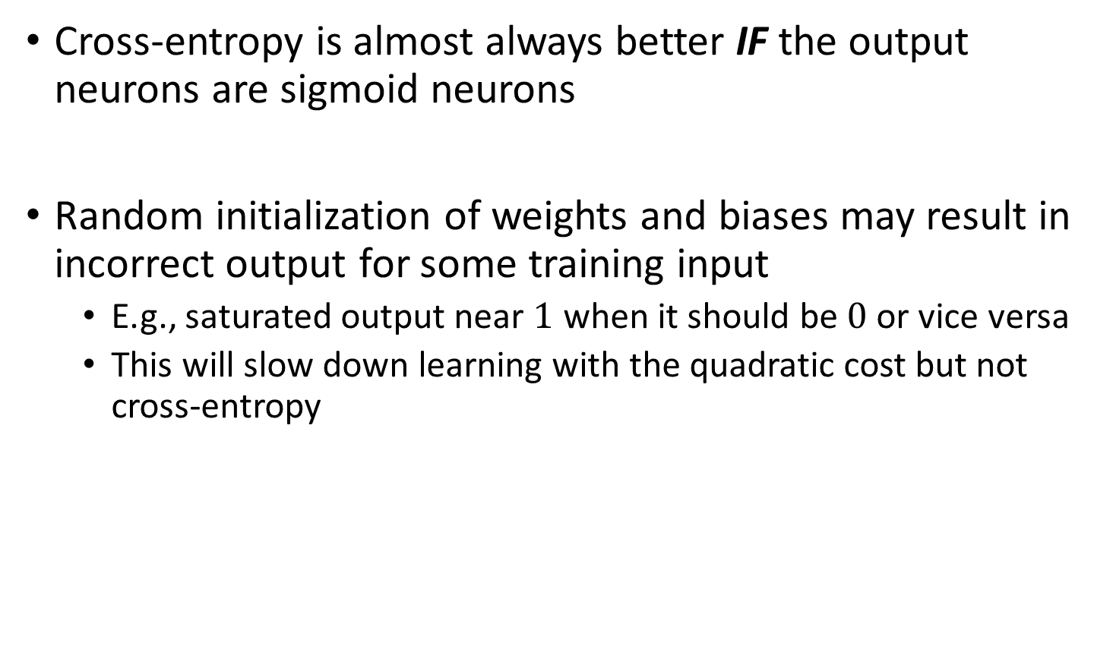
Cross-entropy vs quadratic loss
Cross-entropy is almost always better IF the output neurons are sigmoid neurons
Random initialization of weights and biases may result in incorrect output for some training input
E.g., saturated output near $1$ when it should be $0$ or vice versa
This will slow down learning with the quadratic cost but not cross-entropy

Slide 23
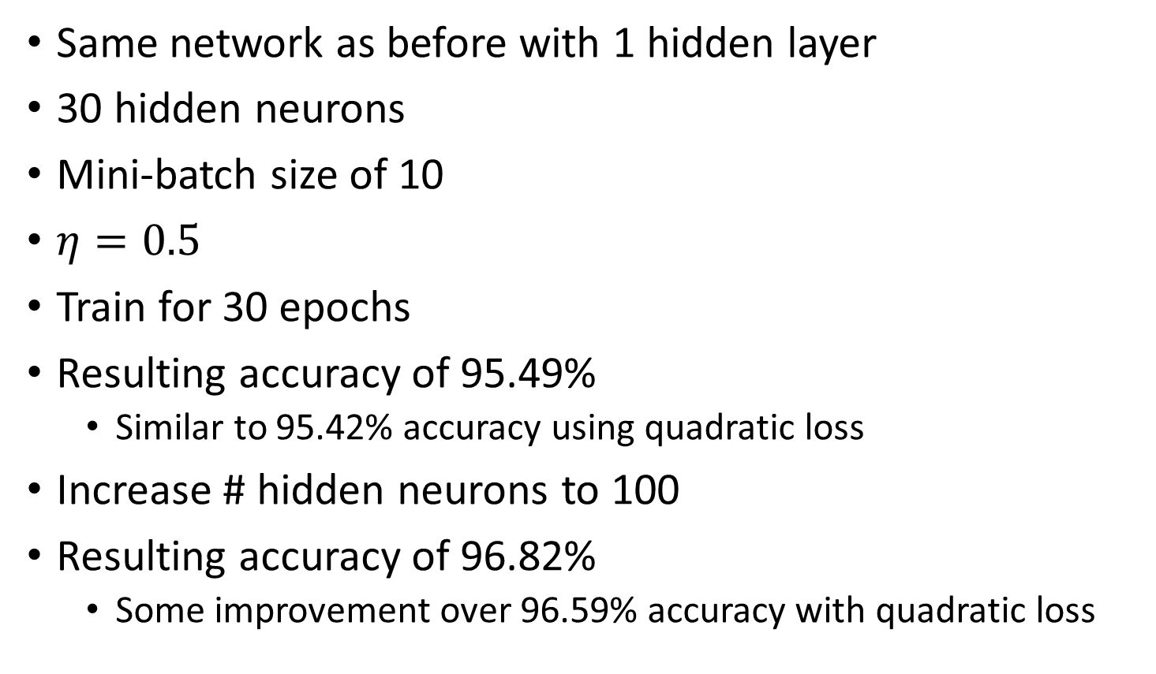
Cross-entropy applied to MNIST
Same network as before with 1 hidden layer
30 hidden neurons
Mini-batch size of 10
$η=0.5$
Train for 30 epochs
Resulting accuracy of 95.49%
Similar to 95.42% accuracy using quadratic loss
Increase # hidden neurons to 100
Resulting accuracy of 96.82%
Some improvement over 96.59% accuracy with quadratic loss

Slide 24
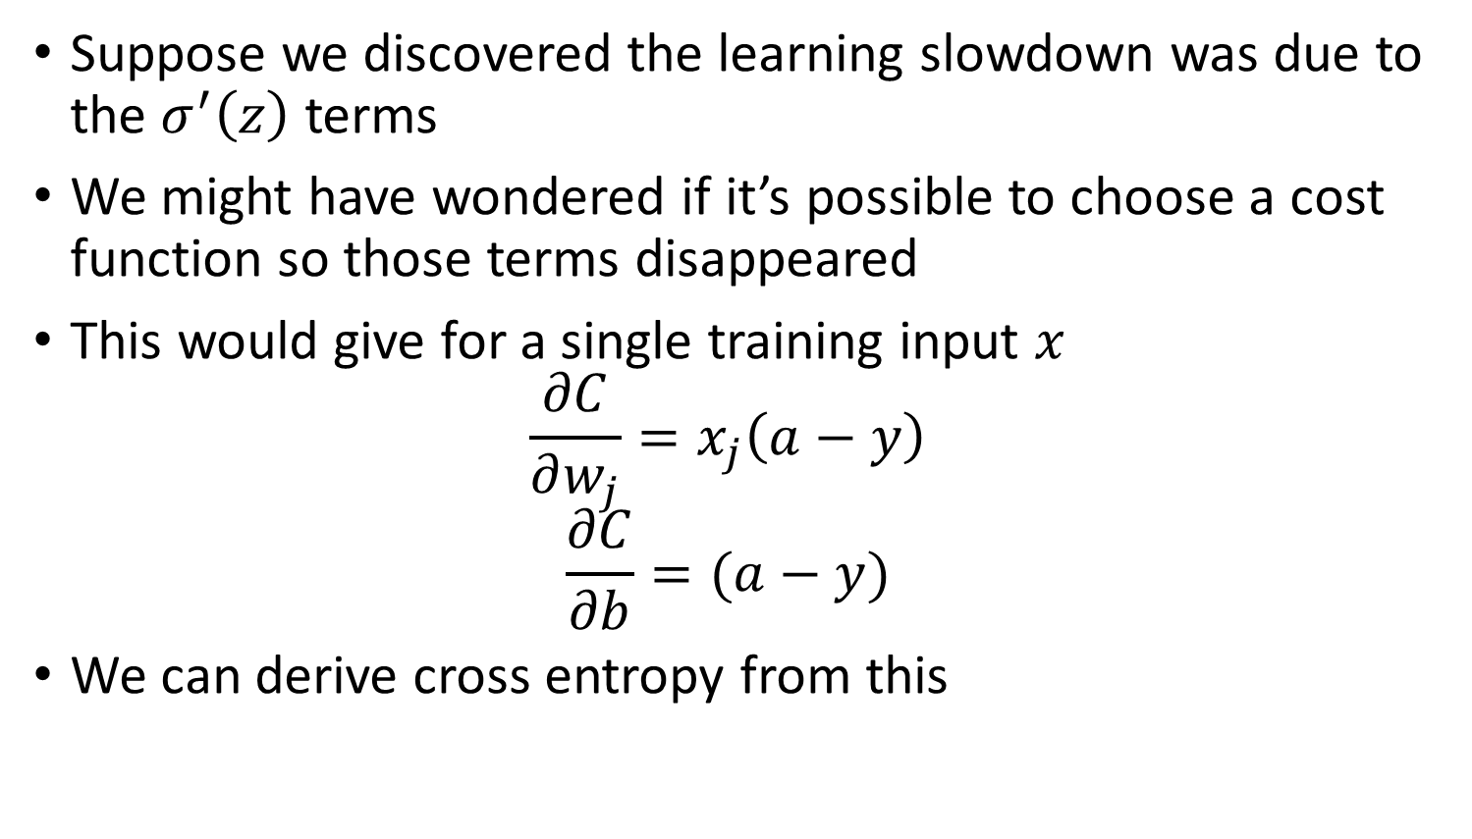
Different derivation of cross entropy
Suppose we discovered the learning slowdown was due to the $σ^{′}\left(z\right)$ terms
We might have wondered if it’s possible to choose a cost function so those terms disappeared
This would give for a single training input $x$
$$\frac{∂C}{∂w_{j}}=x_{j}\left(a−y\right)$$
$$\frac{∂C}{∂b}=(a−y)$$
We can derive cross entropy from this

Slide 25
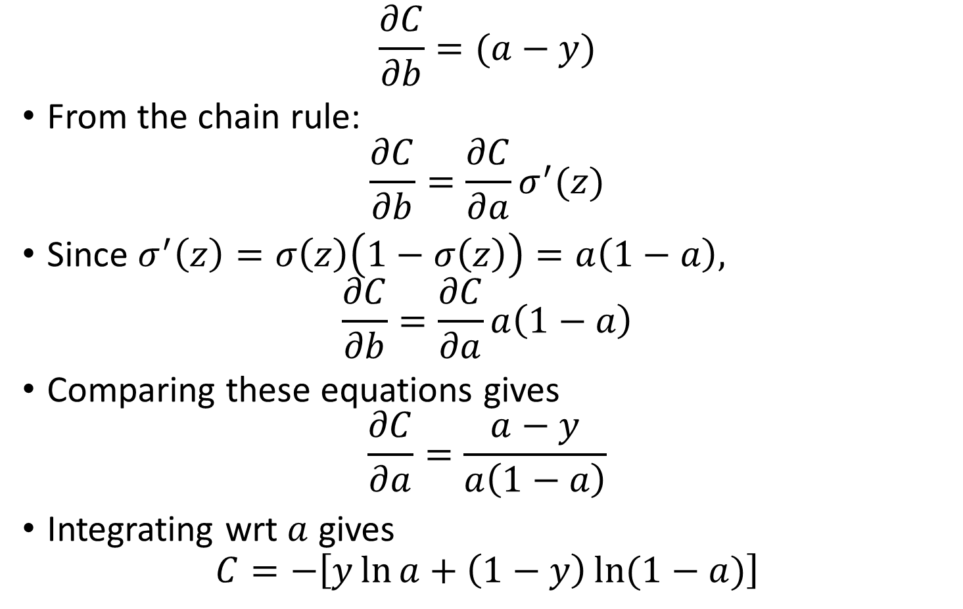
Where does cross-entropy come from?
$$\frac{∂C}{∂b}=(a−y)$$
From the chain rule:
$$\frac{∂C}{∂b}=\frac{∂C}{∂a}σ^{′}(z)$$
Since $σ^{′}\left(z\right)=σ\left(z\right)\left(1−σ\left(z\right)\right)=a\left(1−a\right),$
$$\frac{∂C}{∂b}=\frac{∂C}{∂a}a\left(1−a\right)$$
Comparing these equations gives
$$\frac{∂C}{∂a}=\frac{a−y}{a\left(1−a\right)}$$
Integrating wrt $a$ gives
$$C=−\left[y\ln{a}+\left(1−y\right)\ln{(1−a)}\right]$$
Notes:
We can obtain the final cost function by averaging over training examples

Slide 26
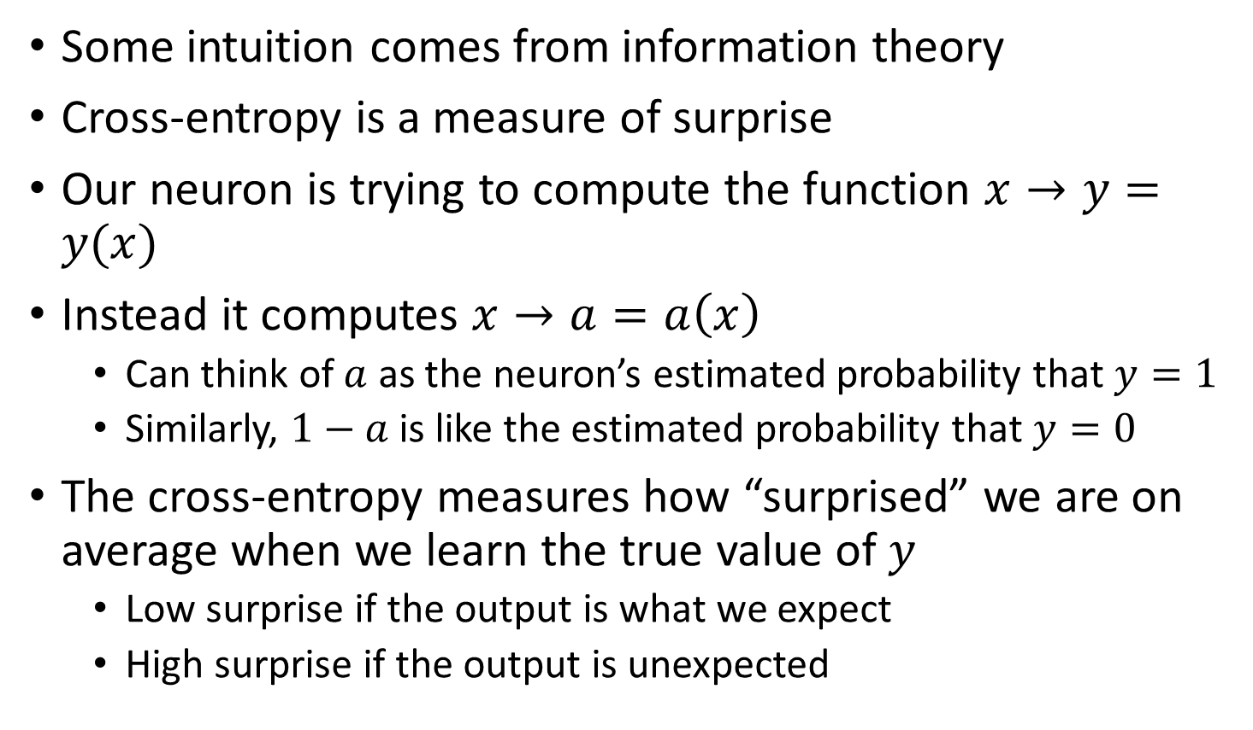
Some intuition to cross-entropy
Some intuition comes from information theory
Cross-entropy is a measure of surprise
Our neuron is trying to compute the function $x→y=y(x)$
Instead it computes $x→a=a\left(x\right)$
Can think of $a$ as the neuron’s estimated probability that $y=1$
Similarly, $1−a$ is like the estimated probability that $y=0$
The cross-entropy measures how “surprised” we are on average when we learn the true value of $y$
Low surprise if the output is what we expect
High surprise if the output is unexpected

Slide 27
Back to the design
We tried to tweak the cost function to have high gradients when far away from the right answer
Can we change activation function instead?
Thus far we have talked about sigmoidal activations
There are many other possibilities

Slide 28
tanh
Has the same problem as sigmoid (flattening gradients)

Slide 29
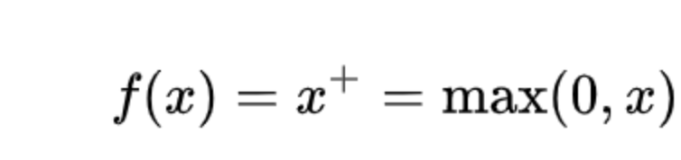
RelU

Slide 30
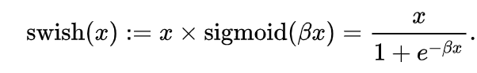
Swish

Slide 31
Softmax

Slide 32
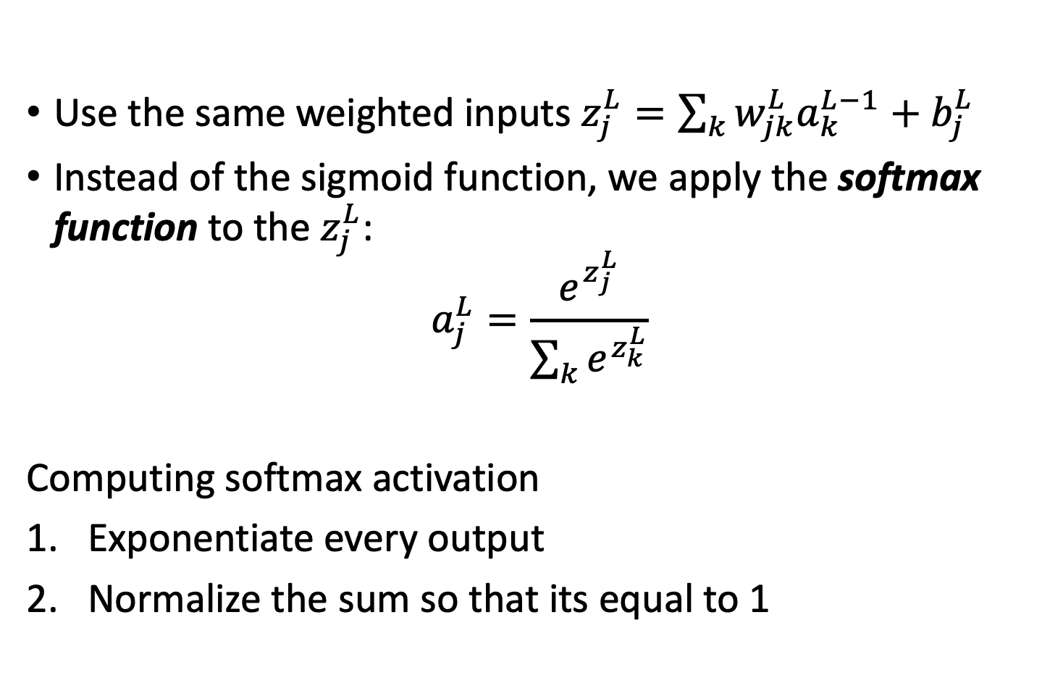
Softmax
Use the same weighted inputs $z_{j}^{L}=\sum_{k}{w_{jk}^{L}a_{k}^{L−1}+b_{j}^{L}}$
Instead of the sigmoid function, we apply the softmax function to the $z_{j}^{L}$:
$$a_{j}^{L}=\frac{e^{z_{j}^{L}}}{\sum_{k}{e^{z_{k}^{L}}}}$$
Computing softmax activation
Exponentiate every output
Normalize the sum so that its equal to 1
Notes:
Go to the link to play around with softmax a bit

Slide 33
Softmax activation

Slide 34
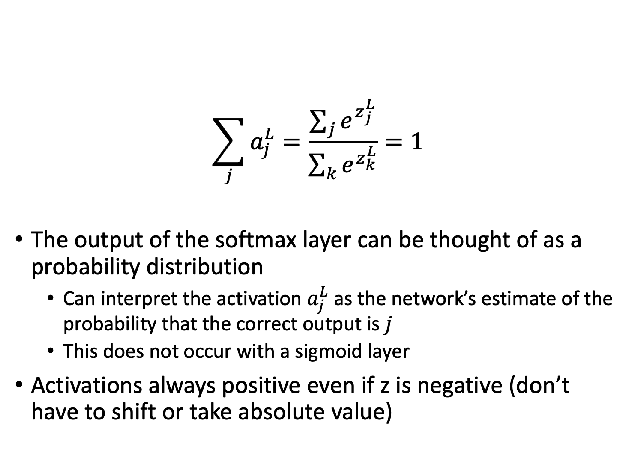
Properties of softmax
$$\sum_{j}{a_{j}^{L}}=\frac{\sum_{j}{e^{z_{j}^{L}}}}{\sum_{k}{e^{z_{k}^{L}}}}=1$$
The output of the softmax layer can be thought of as a probability distribution
Can interpret the activation $a_{j}^{L}$ as the network’s estimate of the probability that the correct output is $j$
This does not occur with a sigmoid layer
Activations always positive even if z is negative (don’t have to shift or take absolute value)

Slide 35
Softmax enables probabilistic cost
Recall Negative log likelihood from probability theory
Since softmax gives the probability of the input being in many classes
We can look at the negative log likelihood of the correct class ---always positive value
Measures the “unhappiness” of the network

Slide 36
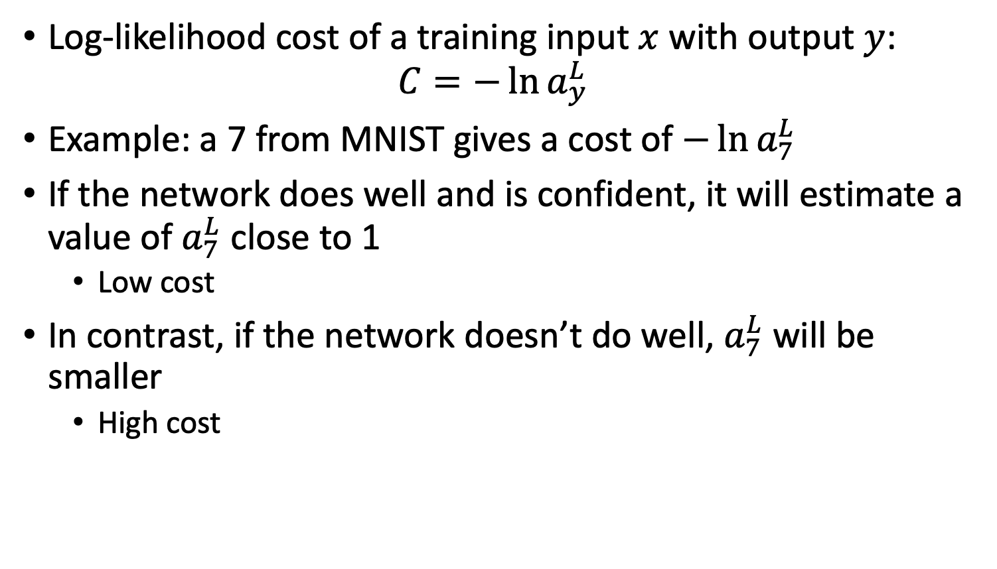
Softmax with log-likelihood
Log-likelihood cost of a training input $x$ with output $y$:
$$C=−\ln{a_{y}^{L}}$$
Example: a 7 from MNIST gives a cost of $−\ln{a_{7}^{L}}$
If the network does well and is confident, it will estimate a value of $a_{7}^{L}$ close to 1
Low cost
In contrast, if the network doesn’t do well, $a_{7}^{L}$ will be smaller
High cost

Slide 37
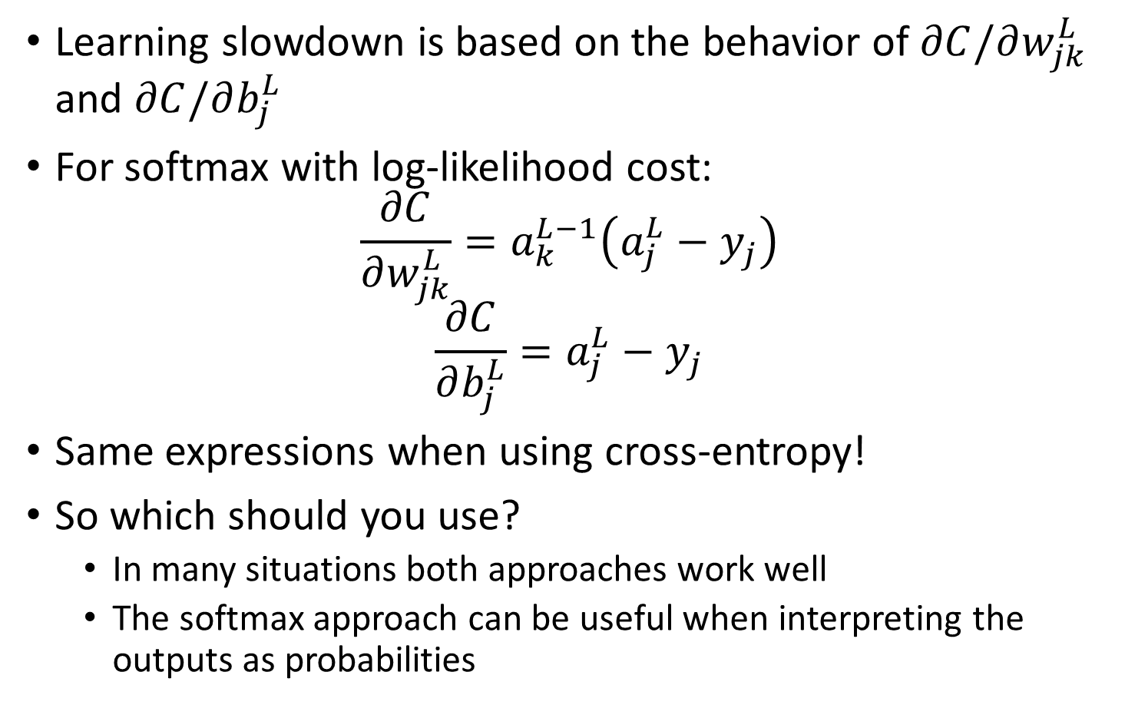
Avoiding slowdown with softmax
Learning slowdown is based on the behavior of $∂C/∂w_{jk}^{L}$ and $∂C/∂b_{j}^{L}$
For softmax with log-likelihood cost:
$$\frac{∂C}{∂w_{jk}^{L}}=a_{k}^{L−1}\left(a_{j}^{L}−y_{j}\right)$$
$$\frac{∂C}{∂b_{j}^{L}}=a_{j}^{L}−y_{j}$$
Same expressions when using cross-entropy!
So which should you use?
In many situations both approaches work well
The softmax approach can be useful when interpreting the outputs as probabilities

Slide 38
Further Reading
Nielsen book, chapter 3

